Slide 1

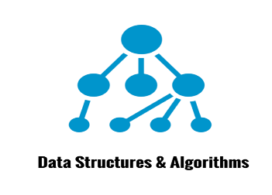
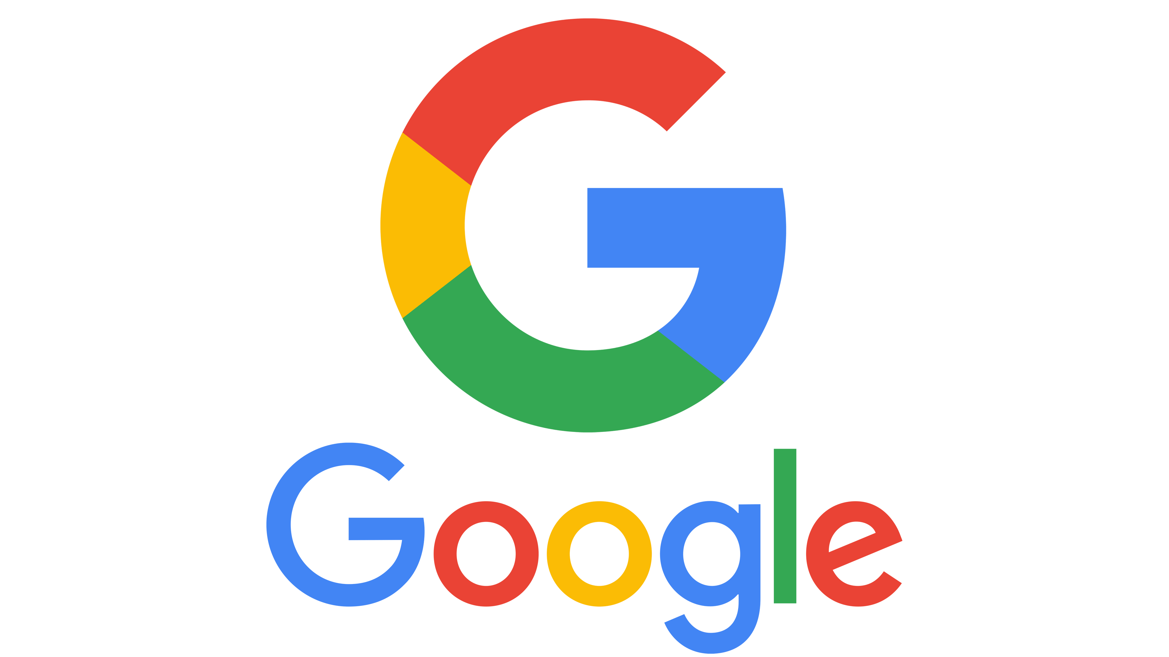
Google’s Knowledge Graph
Worked by: Krisalda Mihali Accepted by: Prof. Evis Plaku

Slide 2
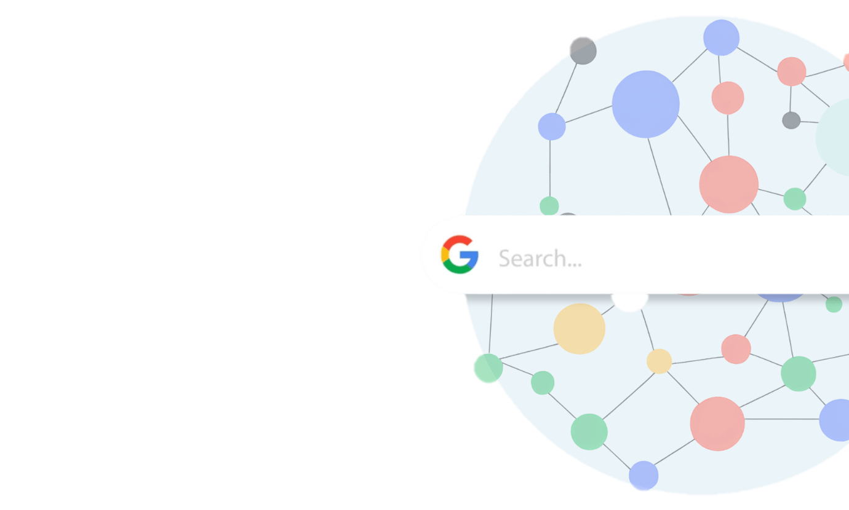
What Is Google’s Knowledge Graph?
Imagine Google has a mind that connects facts, people, and places. That’s the Knowledge Graph!
It’s a digital web where everything is connected—people, events, locations, and ideas.
It helps Google understand what you mean when you search—not just the words you type.

Slide 3
Quick Game – Choose the Right Result!
Search for “Jaguar” – what do you think Google shows first:

Slide 4
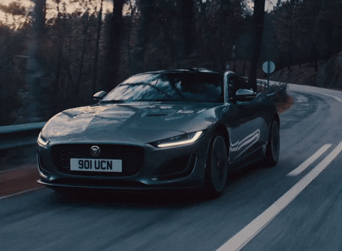
Quick Games – Choose the Right Result!
Search for “Jaguar” – what do you think Google shows first:
1. Car 🚗

Slide 5
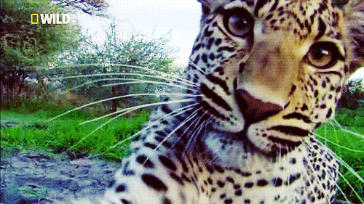
Quick Games – Choose the Right Result!
Search for “Jaguar” – what do you think Google shows first:
1. Car 🚗
2. Animal 🐆

Slide 6
Quick Games – Choose the Right Result!
Search for “Jaguar” – what do you think Google shows first:
1. Car 🚗
2. Animal 🐆
3. Both?

Slide 7
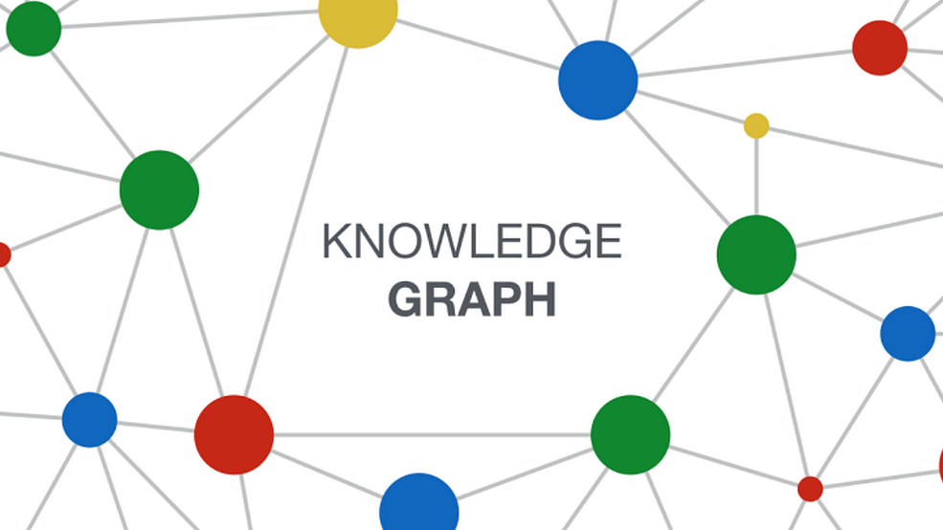
Why Does the Google’s
Knowledge Graph Exist?
Problems It Solves:
Ambiguity in Search: Let’s say you search "Apple"—is it the fruit or the tech giant? The Knowledge Graph knows!
Direct Answers: No need to click on 10 different links. Just ask a question and Google will give you an answer right away (like “Who is Einstein?”).
Contextual Search: Google doesn’t just find keywords. It understands what you're looking for.
Think of it like asking a friend who knows a lot of stuff, not just a search engine!

Slide 8
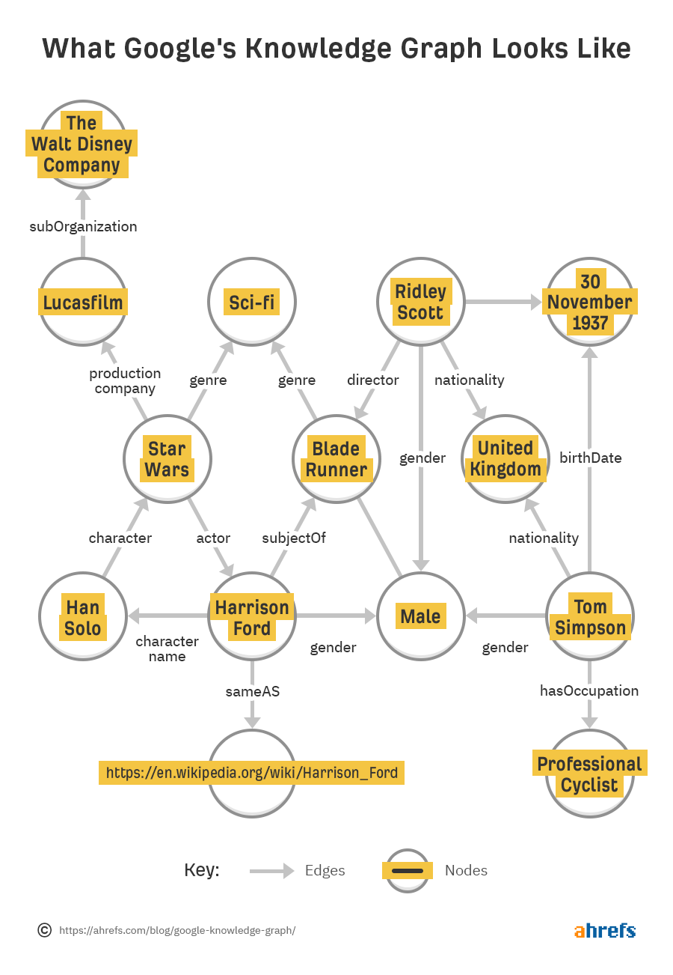
What Does the Google’s Knowledge Graph Look Like?
Nodes = Entities (people, places, things, concepts).
Example: “Albert Einstein” (Person), “Theory of Relativity” (Idea).
Edges = Connections (how entities are related).
Example: “Albert Einstein” → “Theory of Relativity” (Edge: Discovered).
Picture it like a giant web, where every dot is something important, and the lines show how everything is connected.

Slide 9
Guess Who I Am…

Slide 10
Guess Who I Am…
- An apple falling from a tree is often associated with my discovery about the force of gravity.

Slide 11
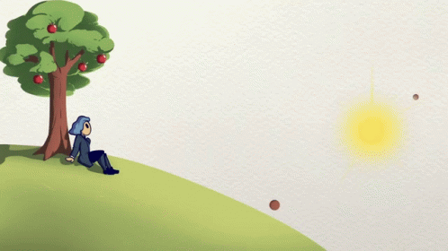
Guess Who I Am…
- An apple falling from a tree is often associated with my discovery about the force of gravity.
Isaac Newton

Slide 12
How Does Graph Theory Make It Work?
Graph Theory is like the secret sauce that makes Google smart!
It helps find the shortest path between things.
So, if you ask "Who invented the light bulb?"
Google follows the correct path from "Thomas Edison" → "Invention" → "Light Bulb.“
It’s smarter than just matching words—Google understands how things relate!
Fun Fact: The Knowledge Graph can connect millions of facts in the blink of an eye!

Slide 13
What Does the Google’s Knowledge Graph Do for You?

Slide 14
Search:
You type “Einstein,” and boom!

Slide 15
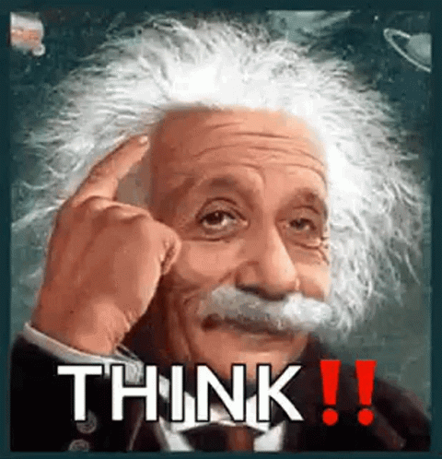
Search:
You type “Einstein,” and boom!
Google gives you his entire life story, key achievements, and even his famous quotes.

Slide 16
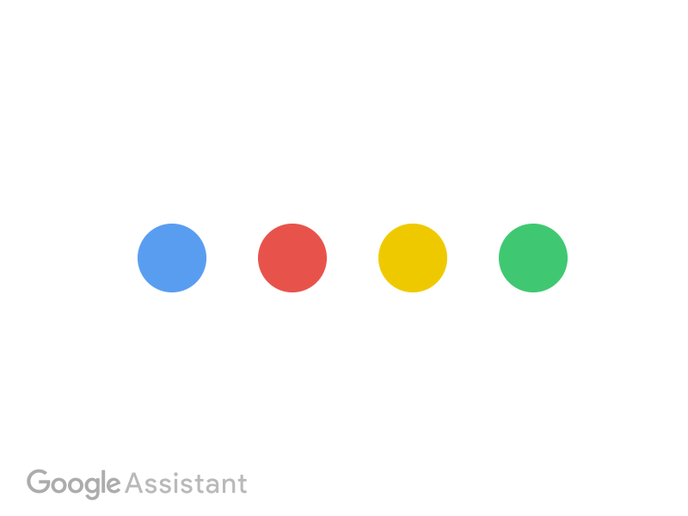
Google Assistant:
Ask, “Who won the Nobel Prize in Physics?” and it instantly pulls the correct answer from the Knowledge Graph.

Slide 17

Recommendations:
It can suggest movies, books, or even new music based on what you like because it knows what’s related!
It’s like having a super-smart friend who always knows the right answer and has a lot of great suggestions.

Slide 18

In Action: How Does It Work?
Example: You search “Who is the president of the USA?”
Google quickly connects the dots: “Donald J. Trump” → “President” → “USA.”
It’s fast and accurate, pulling direct information from the Knowledge Graph—no need to click on multiple links!
The more you interact with Google, the smarter it gets at understanding your questions and giving you the best answers.

Slide 19
Other Uses of Google’s Knowledge Graph by Major Tech Companies
Natural Language Processing (NLP) for Query Understanding
Entity Recognition in Text (Google Search)
Knowledge-based AI Models (Google Cloud AI)
Text Summarization and Sentiment Analysis
Improving Language Models (BERT, T5)

Slide 20

Conclusion
The Google’s Knowledge Graph is like the brain behind smarter Google searches. It connects all the dots to give us the best results fast.
It helps Google understand you, not just find keywords, making it a faster, smarter, and more accurate search experience.
So next time you search, just know—you’re talking to a highly intelligent digital brain that’s always connecting the dots!

Slide 21

Thank you!

